Slide 1

Course Project 3: Image Classification
Hands on Artificial Intelligence and Robotics
Lingxiao Wang, Ph.D.
Assistant Professor of Electrical Engineering
Louisiana Tech University

Slide 2
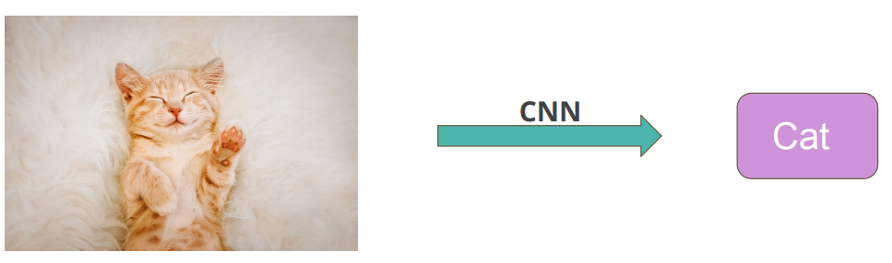
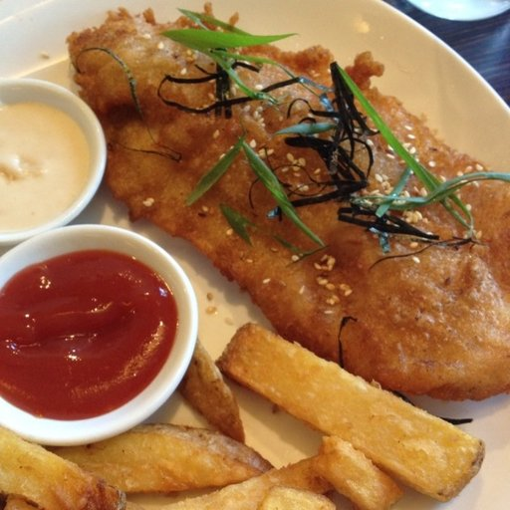
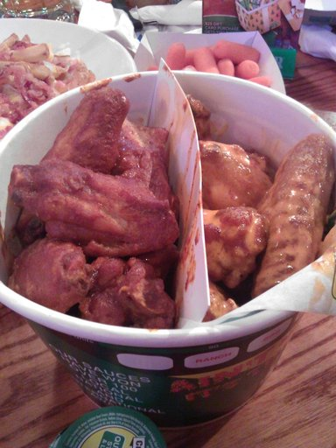
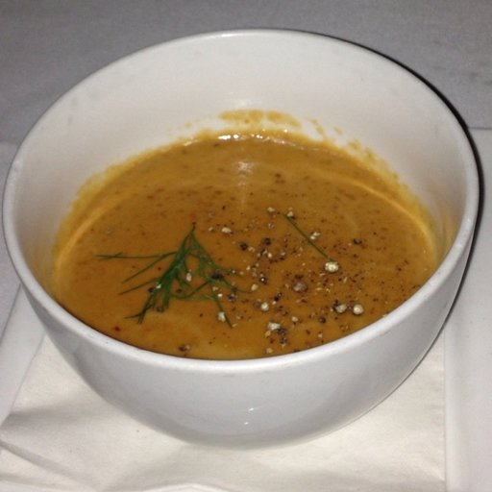
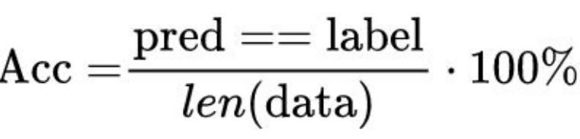
Task Introduction – Image Classification
Solve Image Classification with Convolutional Neural Networks (CNN).
Food-10 Dataset:
Contains 10 different food images
Training set
Validation set
Testing set
Evaluation metrics
Accuracy on testing set:

Slide 3
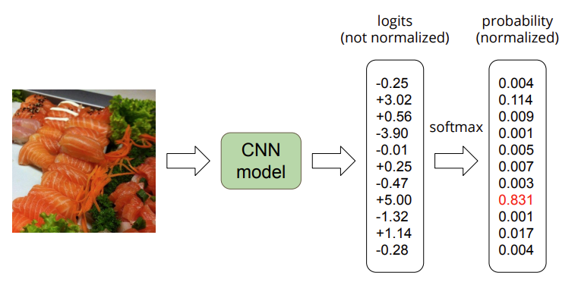
Task Introduction – Image Classification

Slide 4
Grading Policy
Baseline | Accuracy | Hints | Training Time | Grades
Simple | > 0.45 | Run the sample code | ~15 mins | 80
Medium | > 0.6 | Data Augmentation and Longer Trian Epochs | ~ 30 to 60 mins | 90
Strong | > 0.7 | Modify Model structure | ~ 1.5 to 2 hours | 95
BOSS | > 0.8 | Use Pre-trained model | ~ 5 to 8 hours | 100

Slide 5
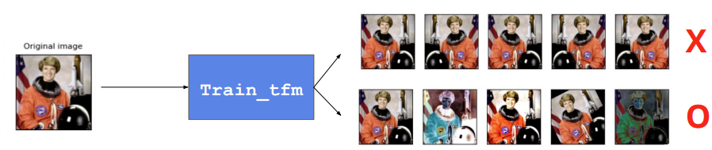
Data Augmentation Implementation
Implement augmentation by completing “train_tfm” function in the sample code with image size of your choice.
Your “train_tfm” needs to produce at least 5 different results for a single image
Use this link to find some pre-built image augmentation methods in Pytorch:
https://pytorch.org/vision/stable/transforms.html
Reasonable Transformations
Unreasonable Transformations

Slide 6
New Submission Method
The sample code will generate a ‘submission.csv’ file, which contains predictions of test images.
Download the ‘submission.csv’ from the Colab.
Upload the ‘submission.csv’ to the Kaggle via the link:
https://www.kaggle.com/t/65a4af3c0f974ea3bf64460f7596047a

Slide 7
Sample Code
Link to the Colab:
https://colab.research.google.com/drive/1kFcJYlrXOdyPWjKyIfFFP-FsJa5Okvnx?usp=sharing

